Slide 1

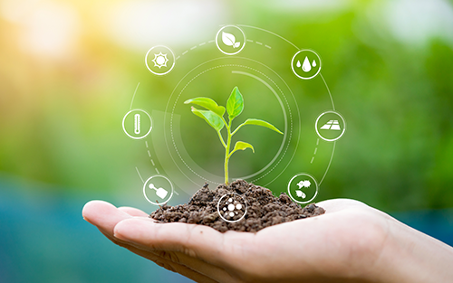
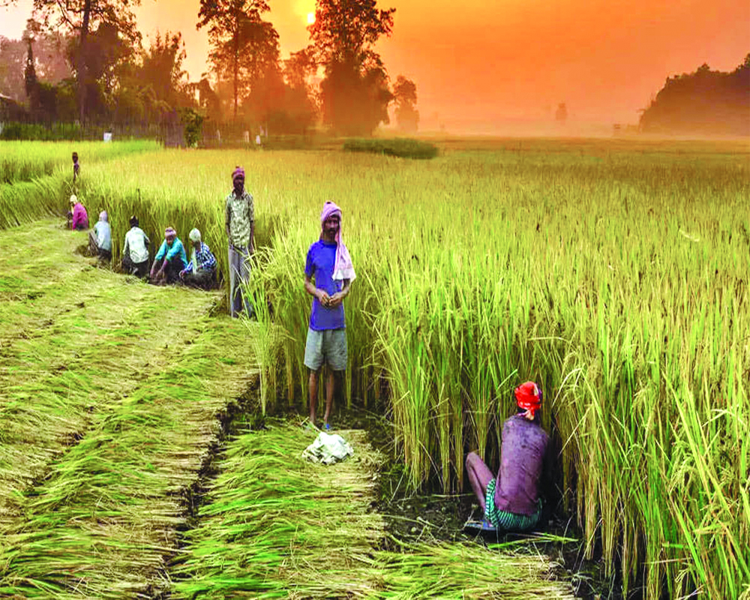
GOVERNMENTS ARTS AND SCIENCE COLLAGE FOR WOMEN,KARIMANGALAM
PROJECT TITLE
INDIA’S AGRICULTURAL CROP PRODUCTION ANALYSIS (1997-2021)
PROJECT SUBMITTED BY
1. MADHUBALA.N
2. LAVANYA.M
3. MEGALA.M
4. MUTHULAKSHIMI.A

Slide 2
INTRODUCTION:
Agriculture encompasses crops and livestock production, aquaculture, fisheries and
forestry for food and non-food products. Agriculture was the key development in the rise
of sedentary human civilization, whereby farming of domesticated species created food
surpluses that enabled people to live in cities.
India is the second largest producer of wheat and rice, the world’s major food staples. India
is currently the world’s second largest producer of several dry fruits, agriculture-based
textile raw materials, roots and tuber crops, pulses, farmer fish, eggs, coconut, sugarcane
and numerous vegetables.

Slide 3
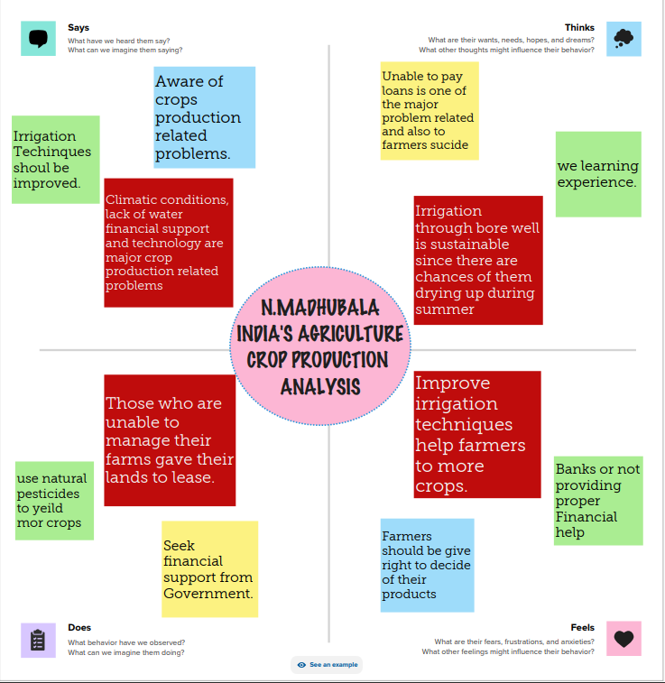
Milestone 1: Define Problem / Problem Understanding
➢ Specify the business problem
➢ Business requirements
➢ Literature Survey
➢ Social or Business Impact

Slide 4
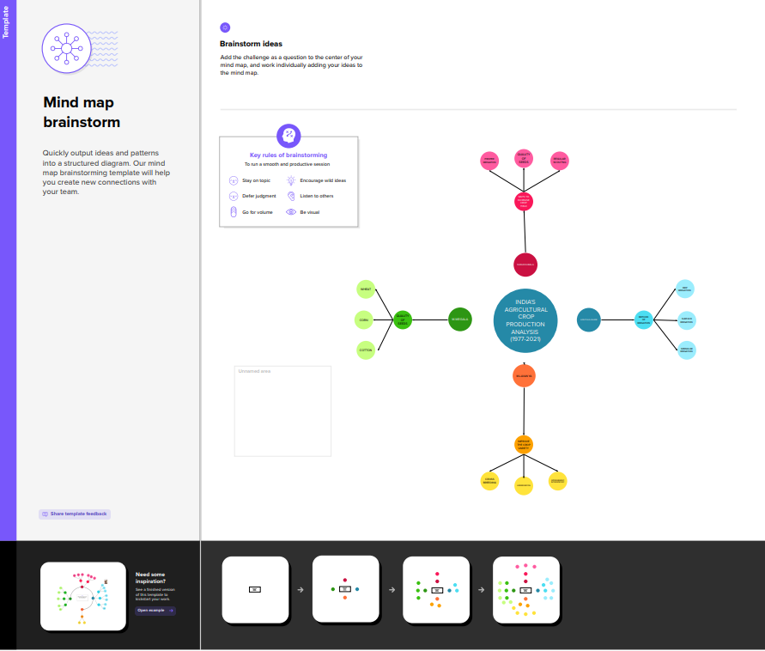

Slide 5
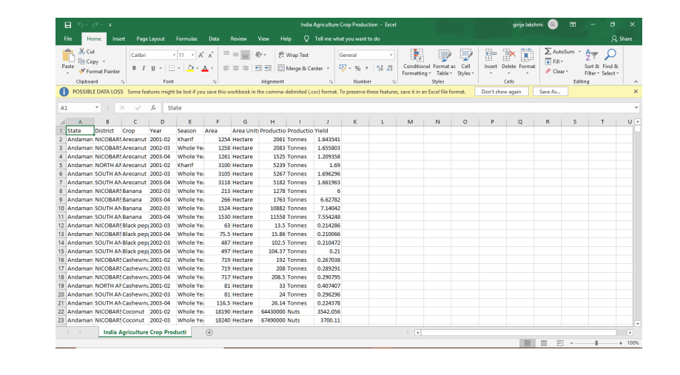
Milestone 2: Data Collection & Extraction
Activity 1: Downloading the dataset

Slide 6
Activity 1.1: Understand the data
Data consists of 345409 rows and 10 columns that correspond to different values.
Column Description of the Dataset:
FIELDS | DESCRIPTION
State | The name of the Indian state
District | The name of the districts of Indian states.
Crop | Name of different crops growth in India
season | India has 5sesons for crop cultivation; kharif, rabi, autumn, winter, and summer.
Area | Area for crop cultivation in acres
Production | Production of crops in tonnes
Yield | Yield by the crops under cultivation

Slide 7
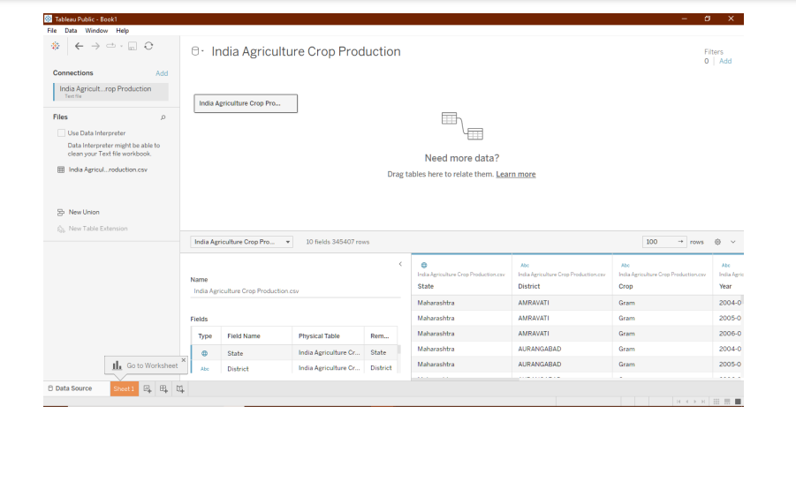
Activity 3: Connect Dataset with Tableau

Slide 8
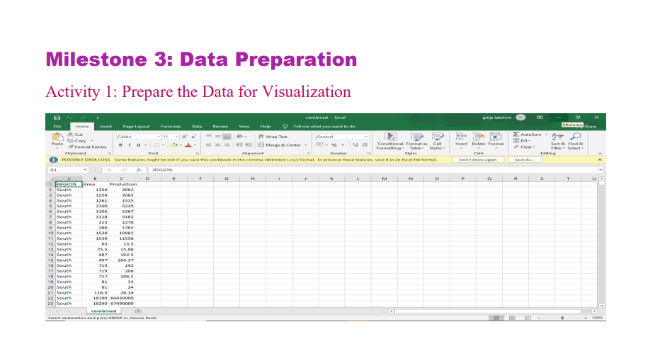
Milestone 3: Data Preparation
Activity 1: Prepare the Data for Visualization

Slide 9
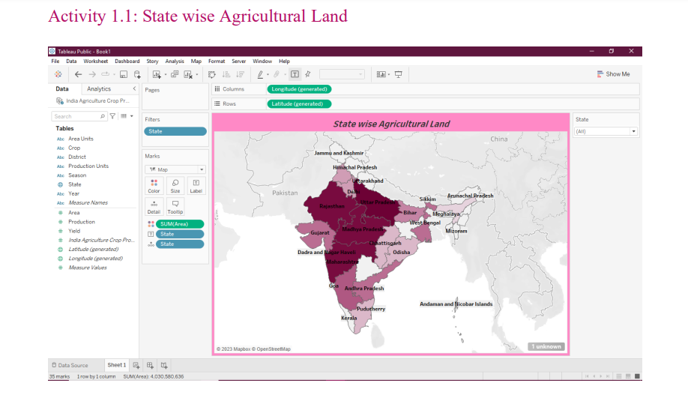
Milestone 4: Data Visualization
Activity 1: No of Unique Visualizations
The number of unique visualizations that can be created with a given dataset.
Activity 1.1: State wise Agricultural Land

Slide 10
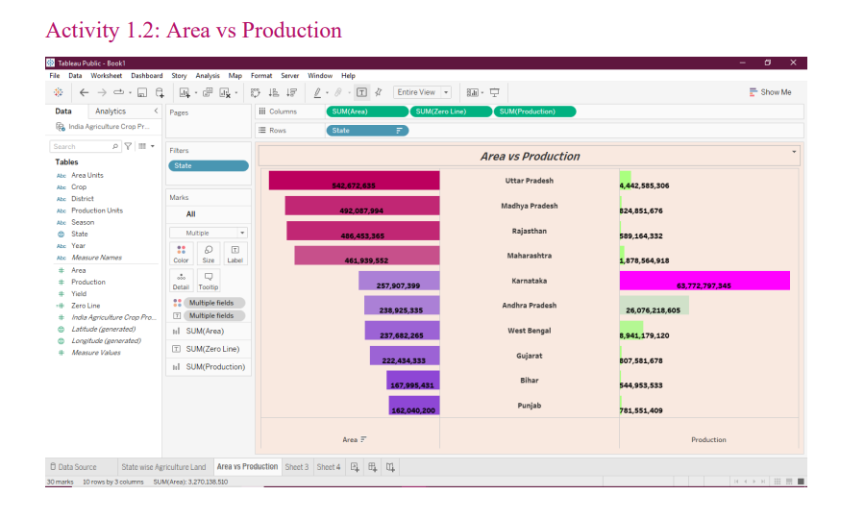

Slide 11
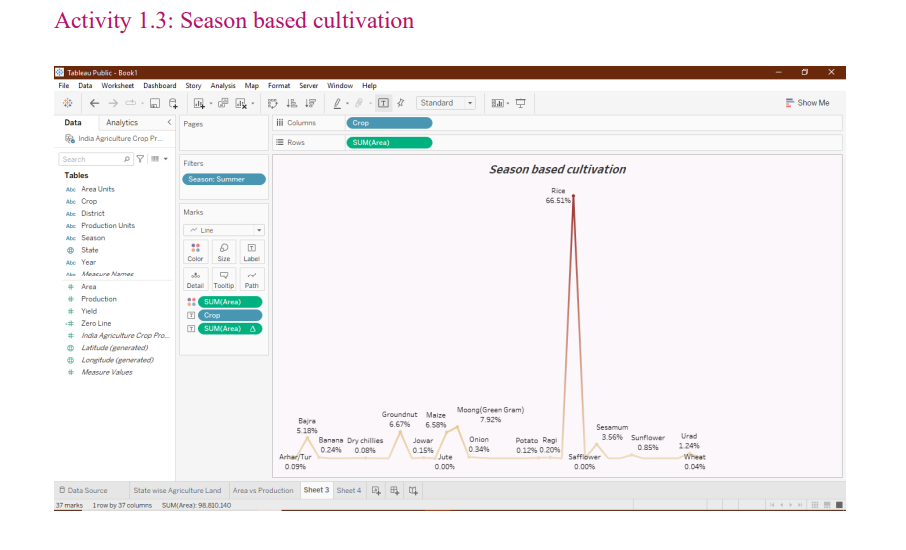

Slide 12
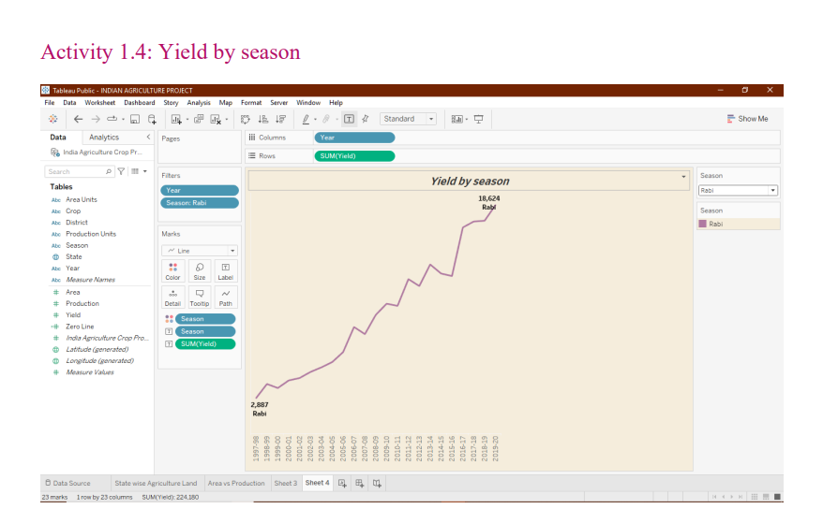

Slide 13
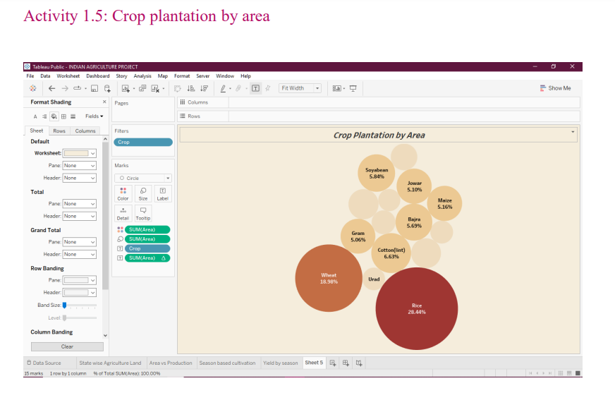

Slide 14
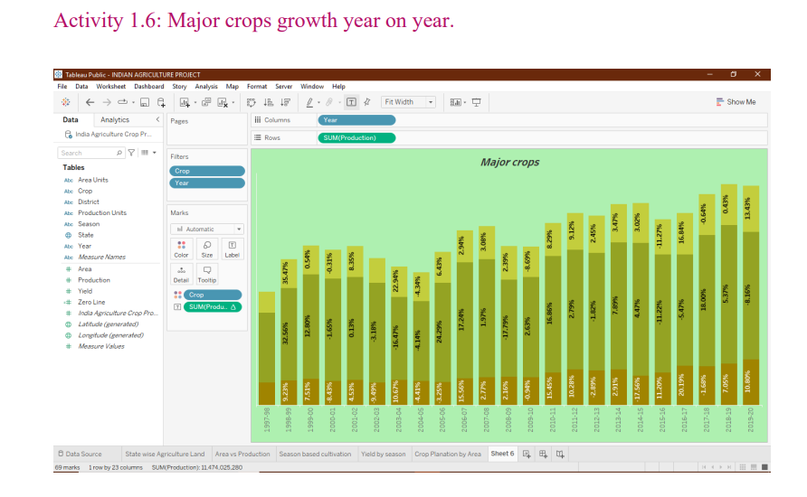

Slide 15
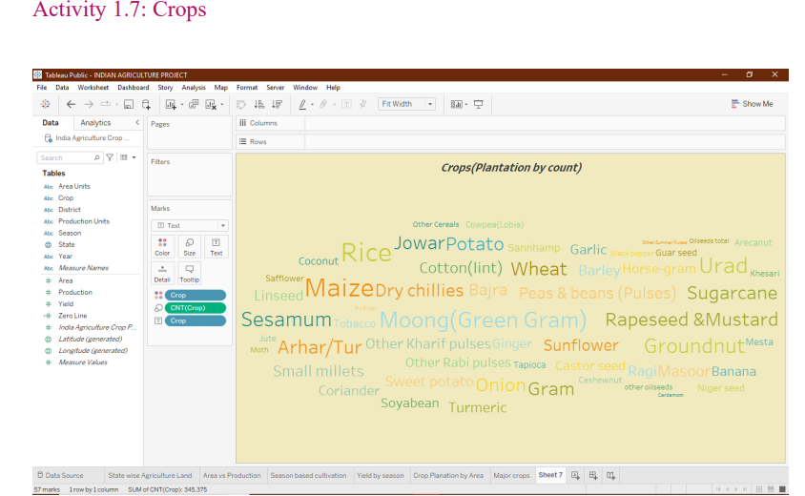

Slide 16
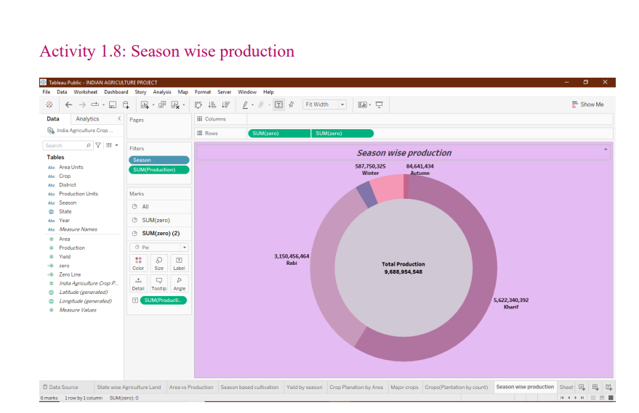

Slide 17
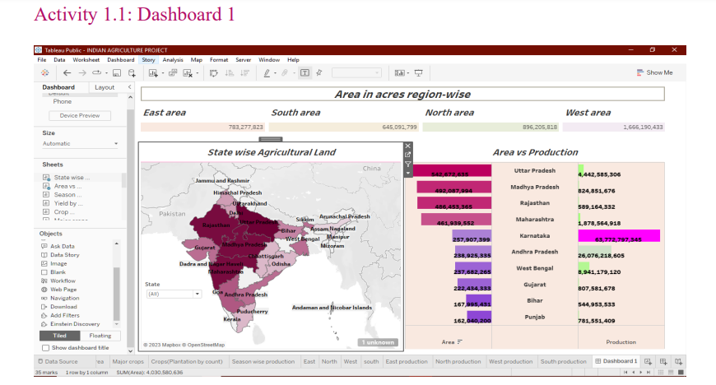

Slide 18
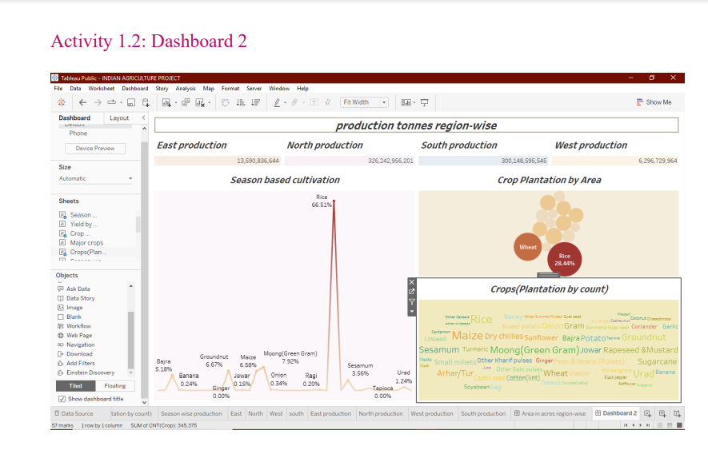

Slide 19
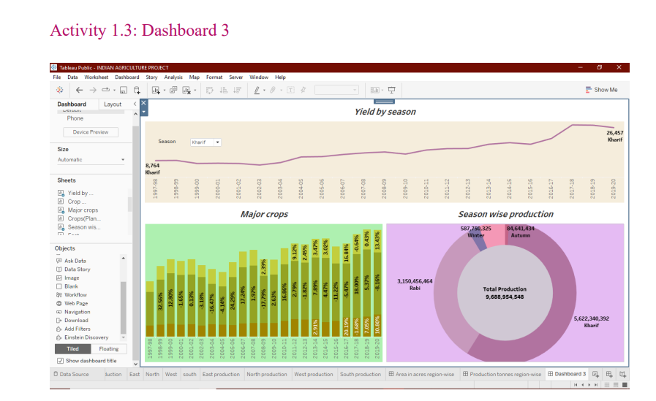

Slide 20
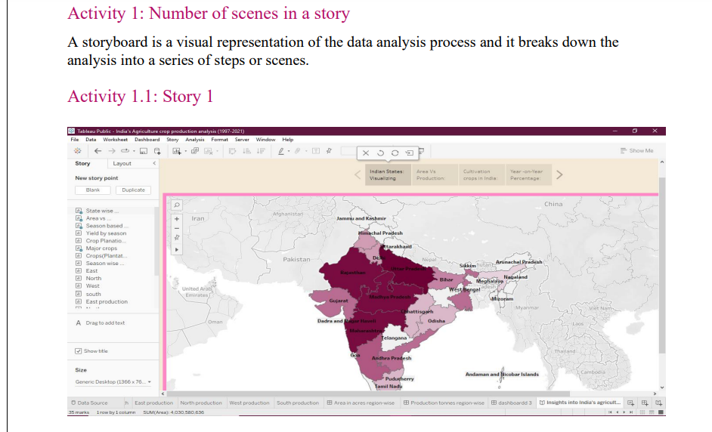
Milestone 6: Story

Slide 21
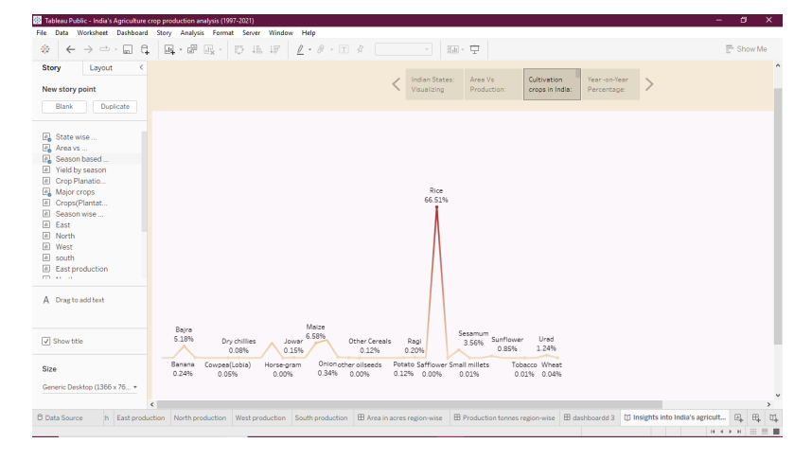

Slide 22
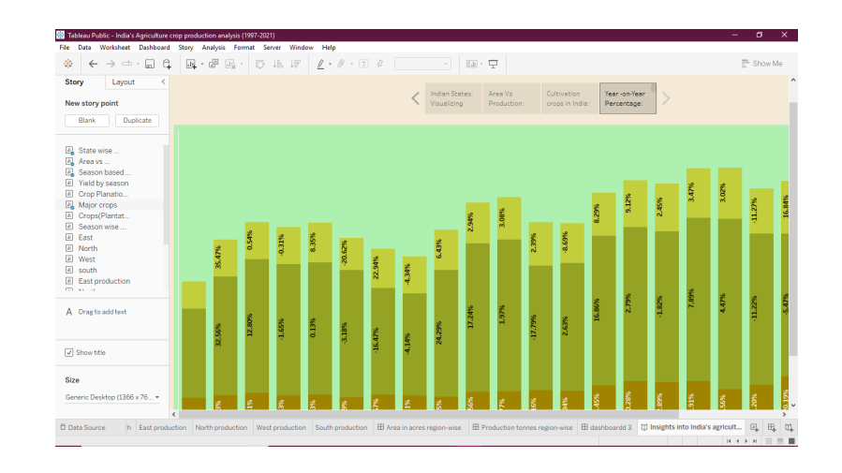

Slide 23
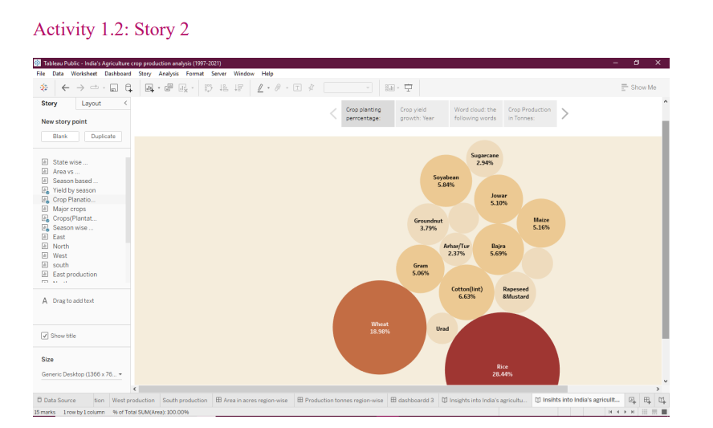

Slide 24
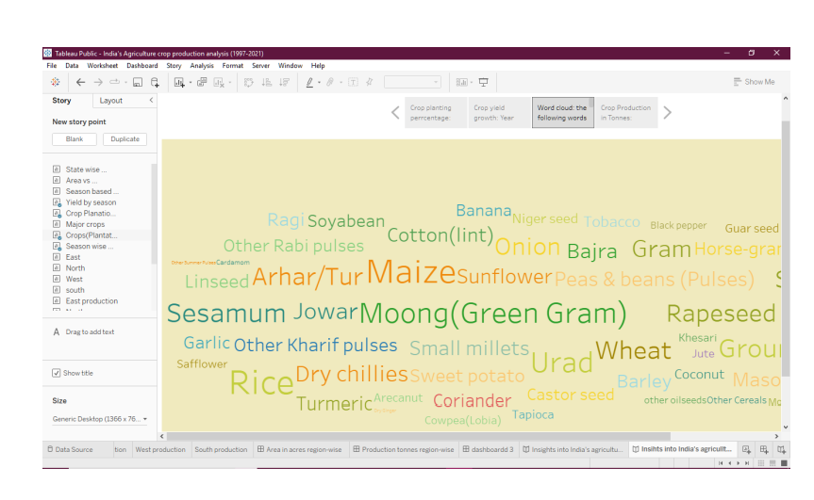

Slide 25
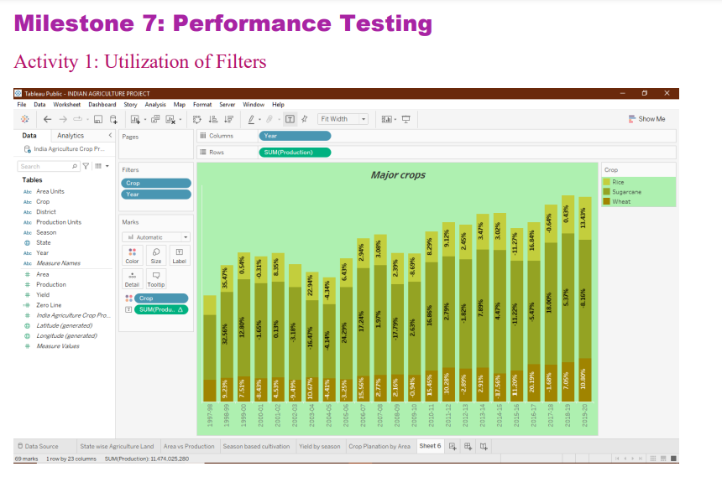

Slide 26
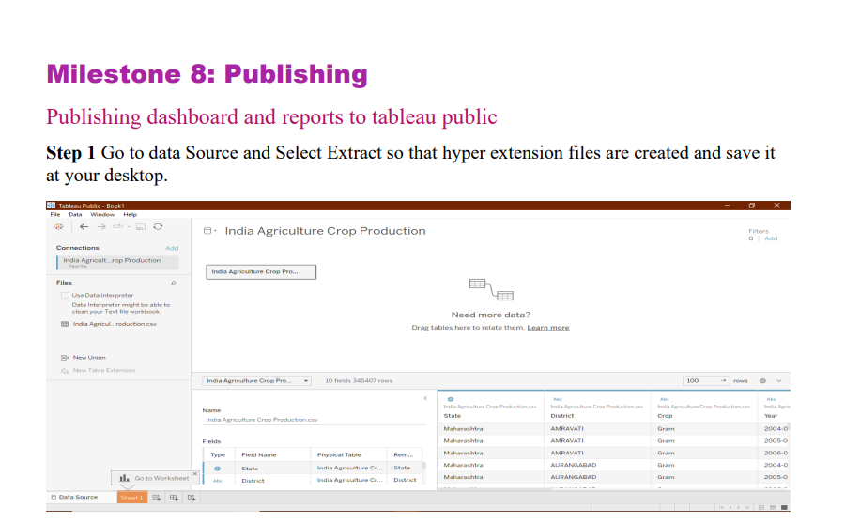

Slide 27
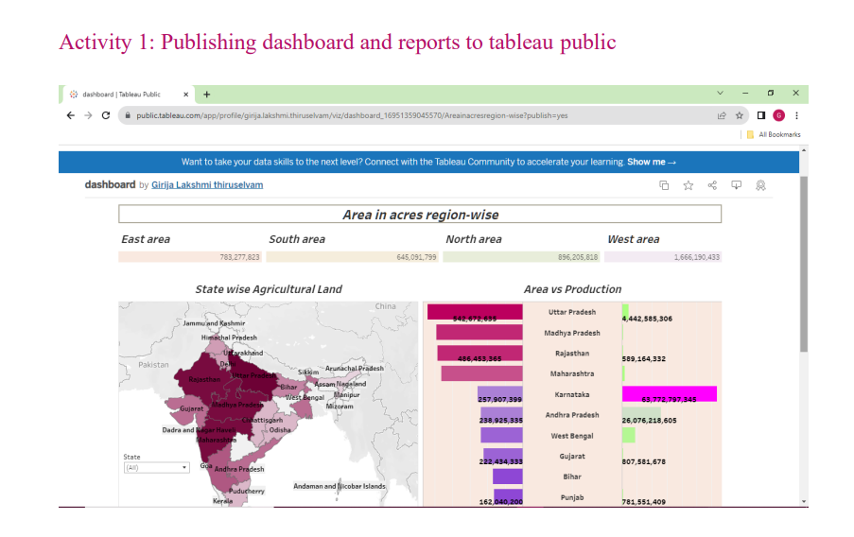

Slide 28
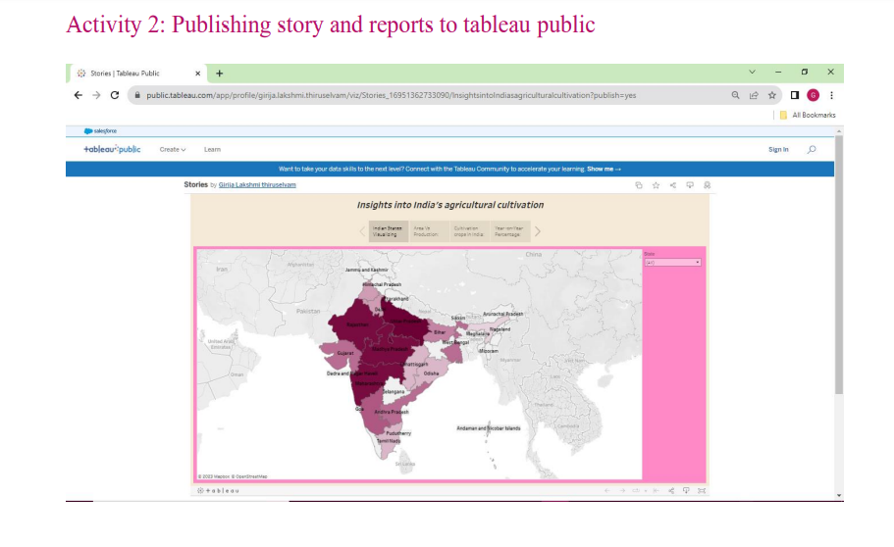

Slide 29
ADVANTAGES & DISADVANTAGES
ADVANTAGE
• Increased Efficiency modern farming methods are more efficient than traditional
methods, with advanced machinery and equipment, allowing farmers to produce
larger quantities of crops in less time and with less labor.
DISADVANTAGE
• Soil Degradation the intensive use of modern farming practices, such as heavy
use of chemical fertilizers and pesticides, can lead to soil degradation over time,
reducing soil fertility and leading to erosion.

Slide 30
CONCLUSION
In this project, we analysis crop production India states year on year. We improve our crop production, we use organic fertilizers and improve soil managements, irrigation system. We use the hybrid seeds to crop. We investing in agricultural technology. Government provides to
farmer to new policy schemes.
FURTURE SCOPE
• Future agriculture will use sophisticated technologies such as robots, temperature and moisture sensors, aerial images, and GPS technology.
• These advanced devices and precision agriculture and robotic systems will allow farms to
be more profitable, efficient, safe, and environmentally friendly
THANK YOU

